Slide 1
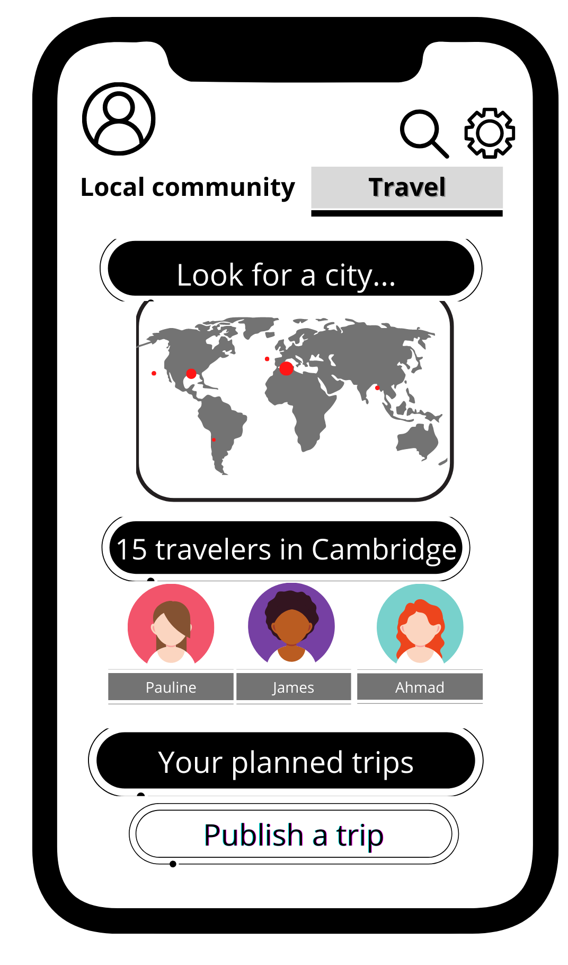
1st iteration
Language exchange app - Travel page
What is it about?
In my language exchange, this page is the section devoted to travels and trips in order for the users to post and publish in advance their booked journeys (specifying dates and city) and for locals to meet a foreigner speaker of their second language and practice and for foreigners to get to know the local language and culture.
Actions for users to take
Users are able to carry out three functions:
look for a city (the one in which they already are or the one to which they are travelling) typing the name of the city in the form. The map will be automatically zoomed in the city typed.
In the section underneath, users will be able to check the travellers present in their city instead.
Finally, at the bottom, they can publish their planned trip. Clicking on that button they will be able to insert the dates and details of their trip

Slide 2
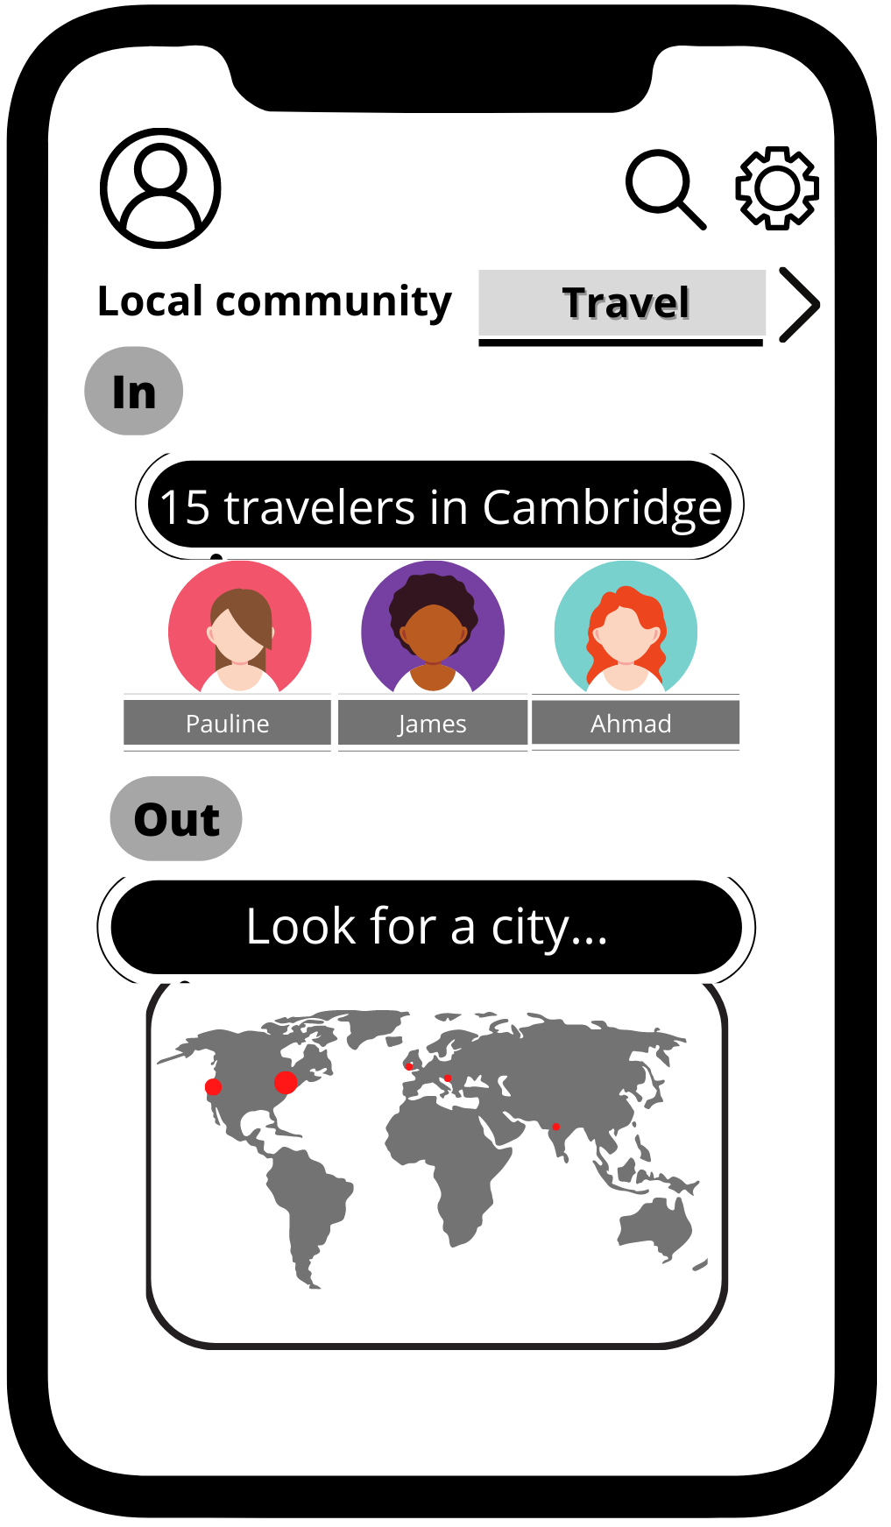
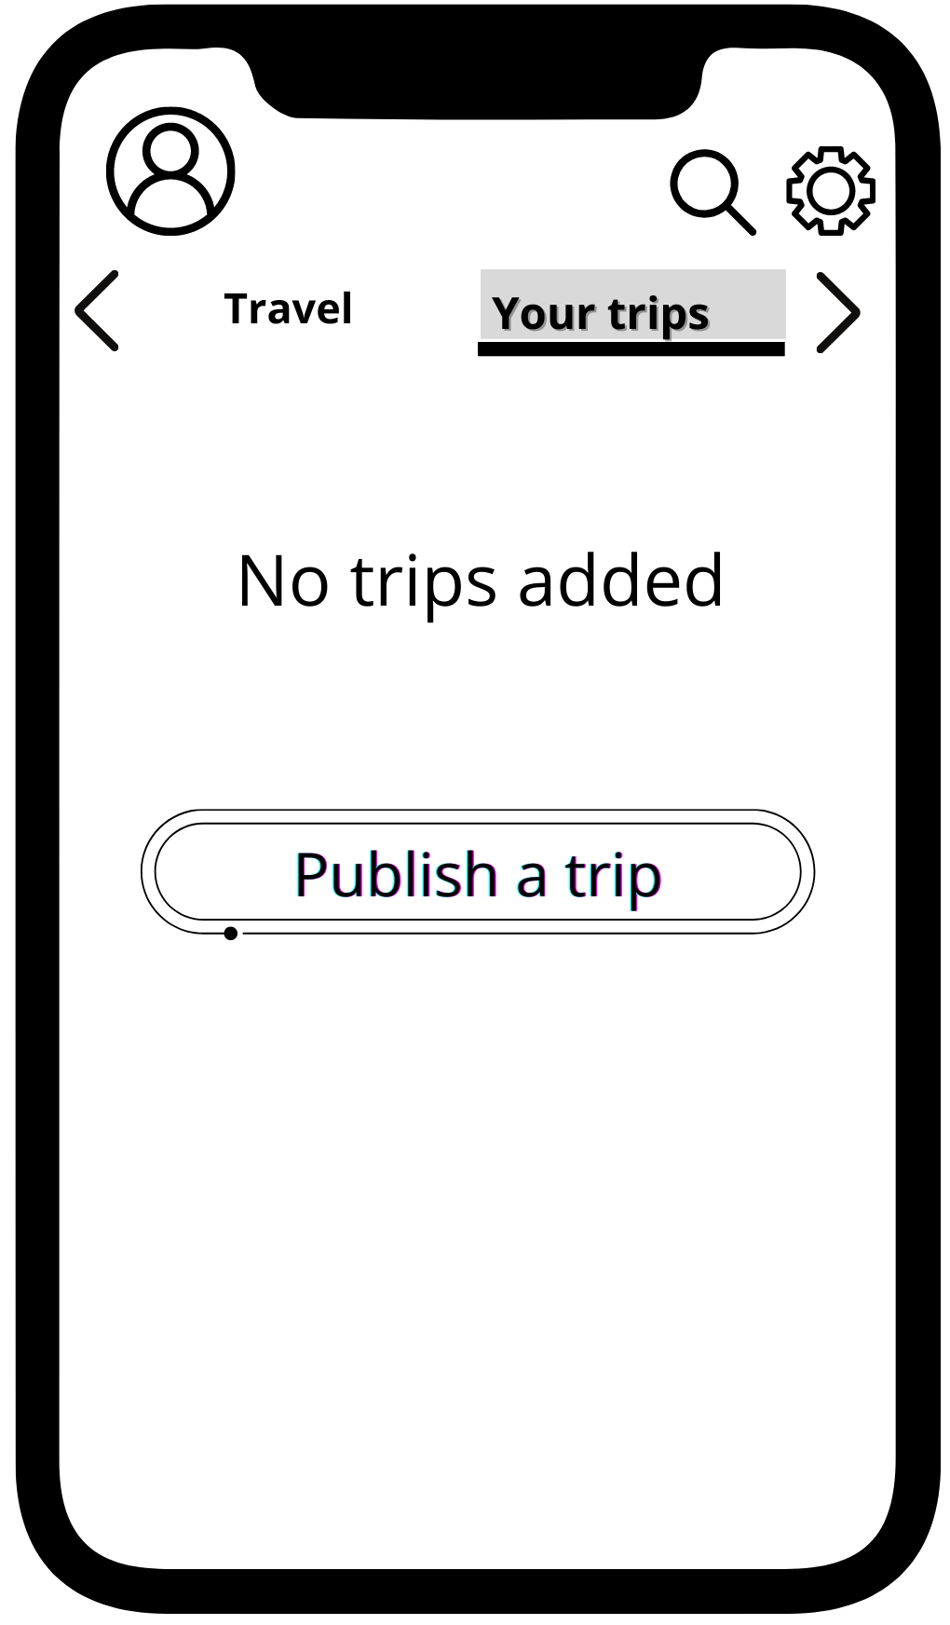
2 nd iteration:
Content divided in two pages in order to make it more digestibile
1 st page
2 nd page
1 st page made up of 2 sections:
In devoted to find travelers in the city specified by the user as city where he lives
Out devoted to find travelers around the world with a search city bar
2 nd page is devoted for users to
check the planned trips that they published
and publish a new trip.

Slide 3
Language exchange app - Travel pages
Research finding applied to the design
One of the key finding of my design was how the passion for discovering a new culture functions as a strong motivation to study a language. The conclusion and recommendation I have drawn from this is that culture can be discovered through travelling and travelers. So, why not connecting language lovers with travelers as often these two categories coincide
Design principle (s) applied
Proximity and Similarity
Intuitivity
Figure and ground
Aesthetic and minimalist design
Design rationales
Pictures of users and their name are grouped together with the same proximity, colours and round shape used in order for user to intuitevely know how to elaborate the information
For the selected page (Travel or your trips) I have used the feature of feature and ground with a grey padding and the writing with a slight shadow in order to create the impression of foreground and background
In order to make it minimalist and aesthetically pleasing, I have decided to devide the content in 2 pages in order not to overwhelm users with 2 many functions in the same page

Slide 4
Throught this icon user will be able to toggle features such as age range of linguistic partner, language spoken and linguisitc level
Design elements explained step-by step
The arrow showcase the presence of a carousel menu to scroll and change page in the app
User can access his profile
Quick prompt In and Out to quickly refer to the concept of inside your local area and outside your local area
Here the city of residence of the user will appear. Clicking on it, user will be directed in a page with the list of travelers in his area
Search bar for a city
When the city will be selected, the map will zoom on it and number of users will be symbolized by a red dot
Bigger the dot, bigger the community of language learners users in the area where the dot is located

